Slide 1

Lightweight Risk Management & Information Assurance Toolkit for Cloud-Based Startups
(Case Study: TravelTech Industry)
Victor C. Okoli
Master of Computing and Information Systems (MCIS)
CSCI 6991 – Data Engineering Capstone
Faculty Advisor: Dr. Yu
Youngstown State University
December 2025
Notes:
Hello everyone. My name is Victor C. Okoli, and this presentation covers my capstone project titled “Lightweight Risk Management and Information Assurance Toolkit for Cloud-Based Startups,” using FlyVnox, my TravelTech startup, as a case study. This project was completed as part of the CSCI 6991 – Data Engineering Capstone at Youngstown State University, under the supervision of Dr. Robert Gilland.

Slide 2
Introduction
• Overview of the importance of data assurance for startups.
• Introduced FlyVnox as a case study (TravelTech SaaS platform).
• Motivation: lack of accessible and structured risk management for small companies.
The rise of cloud-based startups, especially in aviation/travel technology
Startups face security challenges but lack resources for enterprise-level risk programs
Purpose: Build a lightweight, practical, scalable risk-management framework for small startups
Case Study: FlyVnox, a multinational cloud-based airline booking system
Notes:
The purpose of this project is to address a key challenge faced by many early-stage startups - managing security and compliance risks effectively while operating on a small budget. FlyVnox provided the perfect case study for this because it runs on a cloud-based infrastructure handling sensitive traveler data. The toolkit I developed helps startups like FlyVnox identify, assess, and mitigate operational and cybersecurity risks in a simple, automated way.

Slide 3
Background
• Traditional enterprises vs. startups in risk management maturity.
• Startups struggle to implement full ISO 27001 or NIST frameworks.
• Need for a lightweight, adaptive toolkit suited to early-stage budgets.
FlyVnox is a cloud-based airline booking web application
Built using:
Next.js (frontend)
Node.js backend
MongoDB Atlas (database)
Vercel (cloud hosting)
Mystifly GDS API (flight search)
Payment systems: Stripe / Paystack
Handles high-risk data: travel details, emails, phone numbers, booking info, transaction intent
Startups in similar sectors need structured risk approaches without heavy enterprise setups
Notes:
Traditional enterprises have large-scale risk management frameworks, but startups often lack the resources to implement standards like ISO 27001 or NIST CSF. The goal here was to design a lightweight, scalable framework that retains the core value of structured risk management but remains affordable and simple for early-stage companies.

Slide 4

Problem Statement
• Most startups lack a formal process for identifying or tracking data risks.
API breaches
Payment fraud
Cloud misconfigurations
Unauthorized access
System downtime
• Manual risk tracking leads to inconsistent mitigation efforts. Most early-stage founders lack:
Security training
Documentation
Professional policies
Risk registers
• Awareness of compliance requirements is low (GDPR, NIST, etc.).
Notes:
Most startups rely on ad-hoc or manual processes to manage security risks. This leads to inconsistent responses, compliance gaps, and exposure to data threats. There was a clear need for a unified system, something structured yet easy to deploy in a cloud environment

Slide 5
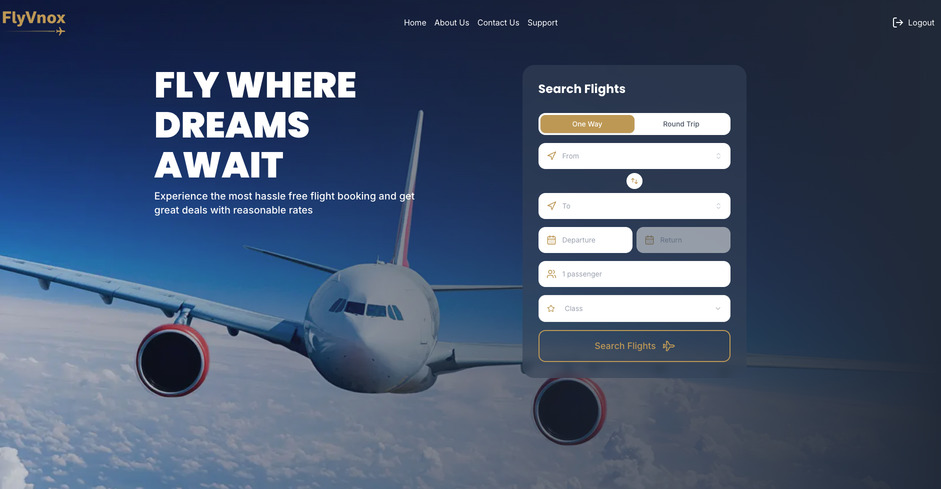
About FlyVnox (Case Study)
A cloud-based TravelTech application built with:
Next.js
Node.js backend
MongoDB Atlas
Vercel hosting
Stripe / Paystack payments
Mystifly Global Distribution System (GDS API)
Handles sensitive data (passport info, payment intent, personal profiles)
Requires strong risk controls despite being an MVP
Notes:
FlyVnox is a cloud-based TravelTech platform designed to simplify global flight search and booking for users across different countries. It is part of the Vnox Technology group and currently operates as an early-stage MVP serving international travelers, students, families, and diaspora communities.

Slide 6
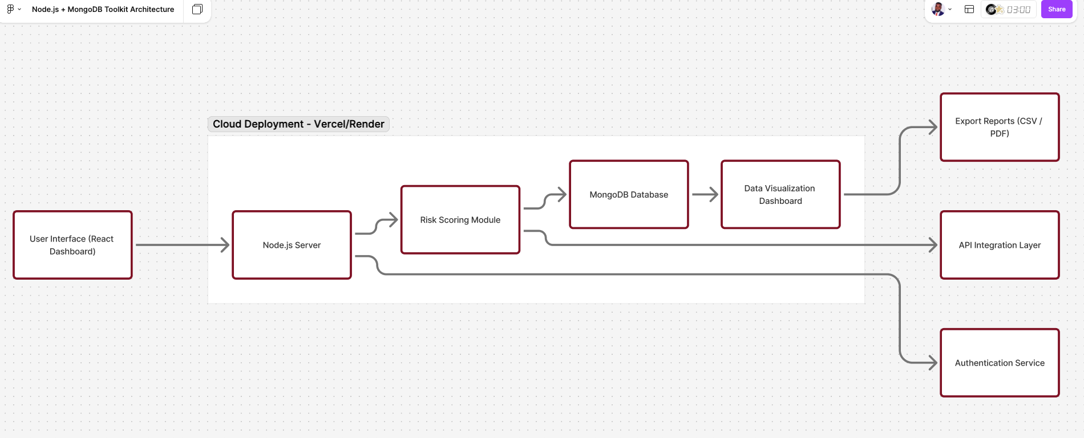
Methodology
The toolkit was developed using three established frameworks:
1. NIST Cybersecurity Framework (CSF)
Identify
Protect
Detect
Respond
Recover
2. ISO 27001 Controls
Asset management
Access control
Information Security Policies
Risk assessment and treatment
3. CIS Critical Security Controls
Basic technical protections
Practical steps for small teams
Approach:
Analyze FlyVnox architecture
Identify risks in each layer (frontend, backend, database, API, cloud)
Map risks to specific controls
Develop templates and documents for startup usage
Notes:
The toolkit uses a modular Node.js and MongoDB architecture, with an optional React interface for visualization. It contains three main modules — a Risk Register, a Risk Matrix, and a Control Mapping Engine linked to frameworks like NIST and ISO. The diagram on this slide illustrates how users interact with the system — from input forms to scoring and storage — through a simple web interface.

Slide 7
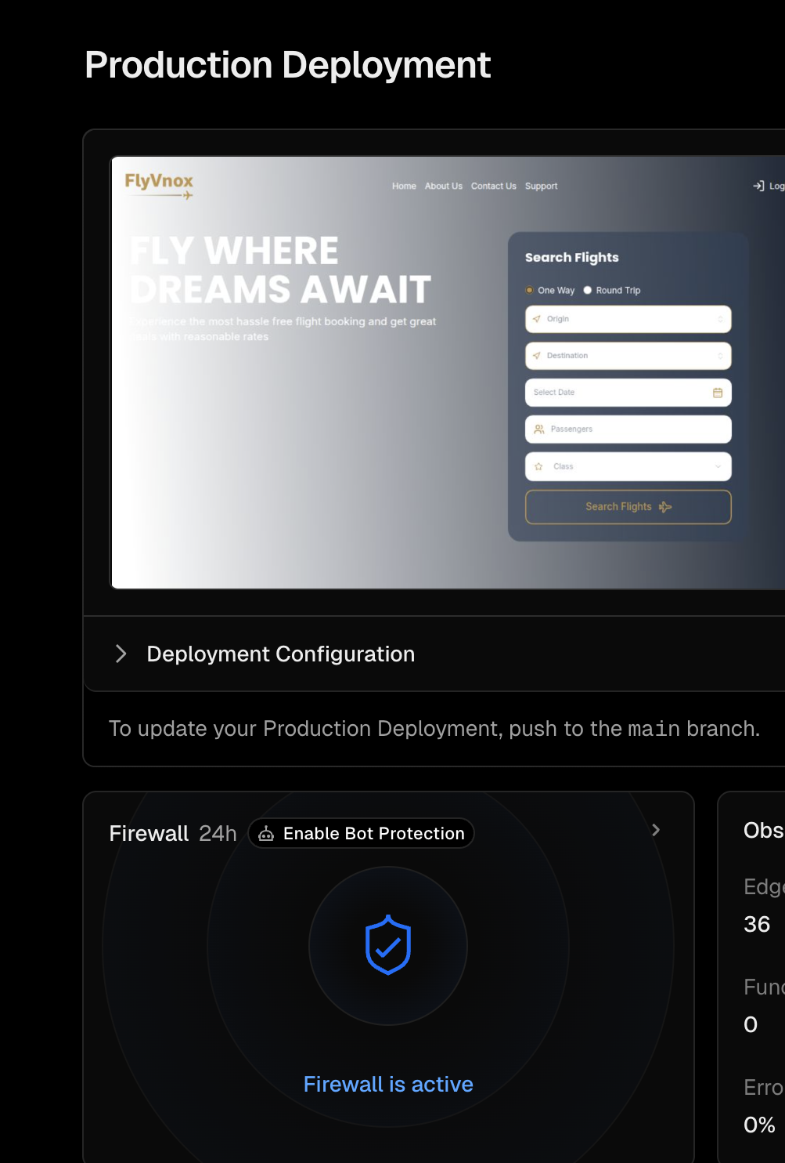

Why FlyVnox Needs Risk Management
Stores customer travel data
Integrates with third-party APIs
Handles payments
Needs compliance readiness for future scaling
Aim: Protect business reputation, investor confidence, and regulatory compliance
Notes:
Why FlyVnox Needs Risk Management?
Stores customer travel data
Integrates with third-party APIs
Handles payments
Needs compliance readiness for future scaling
Aim: Protect business reputation, investor confidence, and regulatory compliance

Slide 8
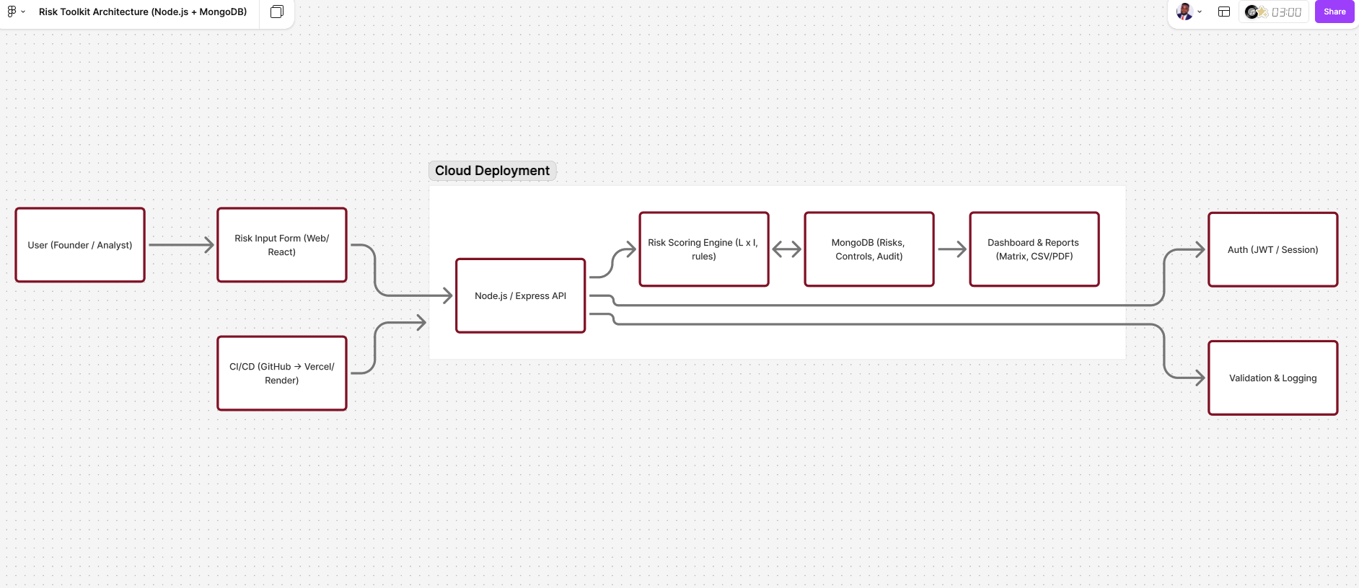
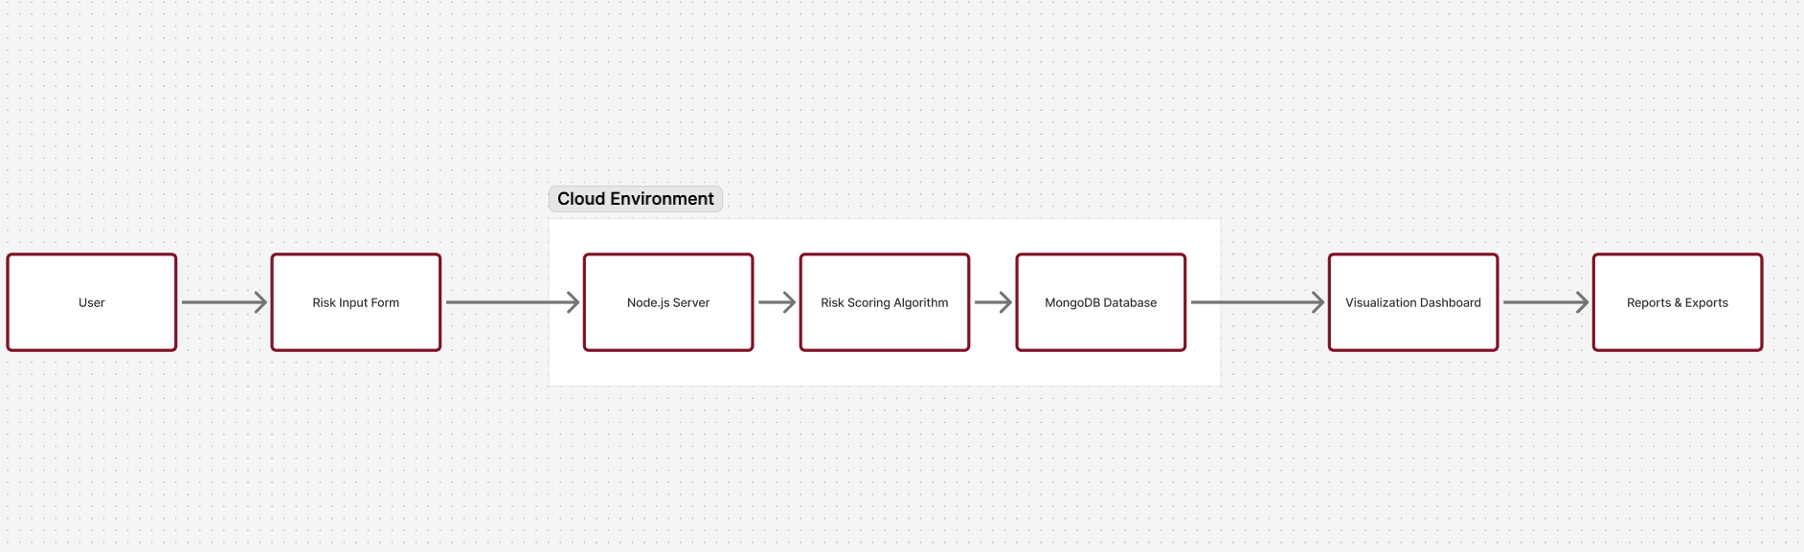
Experiments / Implementation
• Built form-based input system for risk data collection.
• Case study applied to FlyVnox API and backup systems.
• Visualized results in a color-coded matrix (Low–Critical).
• Tools: Node.js, Express, MongoDB Atlas, Render, GitHub.
Notes:
To test the toolkit, I used real-world FlyVnox scenarios such as API security, password management, and backup systems. The risk data entered through the form is automatically scored and plotted on a matrix that helps prioritize actions. I also added an export function to generate CSV or PDF reports for compliance reviews.

Slide 9
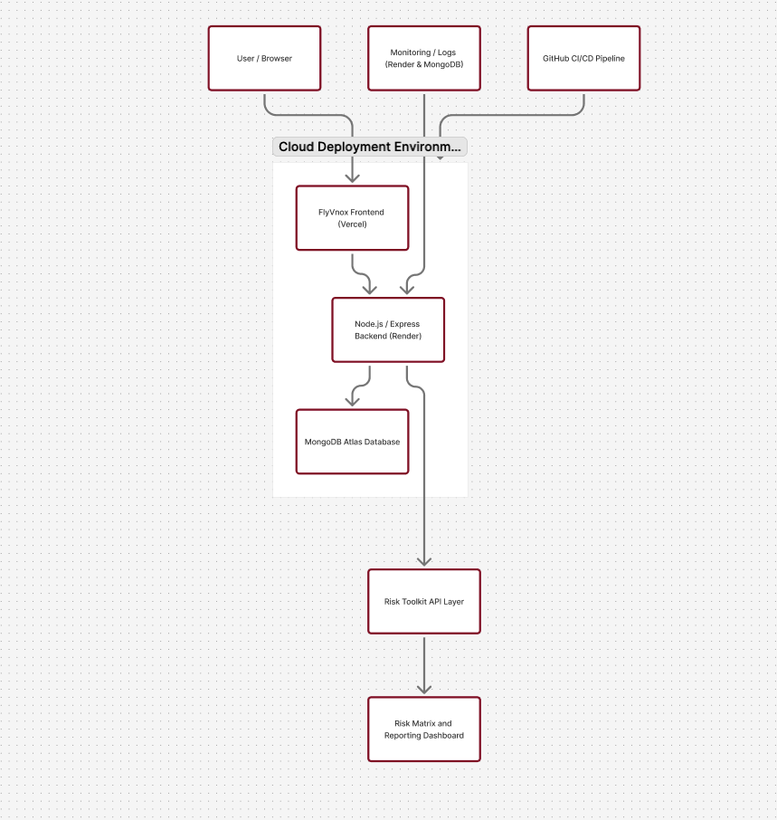
Cloud Deployment
Frontend (Vercel): Hosts the FlyVnox user interface for fast, serverless access.
Backend (Render): Runs the Node.js API and risk scoring services.
Database (MongoDB Atlas): Stores risk data securely with redundancy.
CI/CD (GitHub): Automates deployment and continuous updates.
Notes:
The toolkit is deployed entirely on the cloud for scalability and speed. The frontend runs on Vercel, the backend API on Render, and MongoDB Atlas handles all database operations. Continuous integration through GitHub ensures automated updates, while Render’s built-in monitoring provides system reliability. In short, the entire solution is hosted in a secure, flexible cloud environment — ideal for startups.

Slide 10

Discussion
• Highlights: Improved awareness, fast adoption for startups.
• Challenges: Limited dataset for testing, manual scoring.
• Next steps: Integrate AI-based automation and trend analysis.
The toolkit demonstrates that lightweight security can still be effective
Useful for early-stage startups that cannot afford SOC teams or enterprise auditors
Helps founders prepare for:
Investor due diligence
Compliance expectations
Scaling from MVP to production
FlyVnox’s case shows that applying even simple controls dramatically reduces risk exposure
Cloud-native tools (MongoDB Atlas, Vercel) make implementation easier for small teams
Notes:
The toolkit successfully demonstrated how a small startup can adopt structured risk management without heavy enterprise costs. It improved visibility over risks and helped automate reporting. However, future versions could include predictive analytics to automate control prioritization using machine learning.

Slide 11
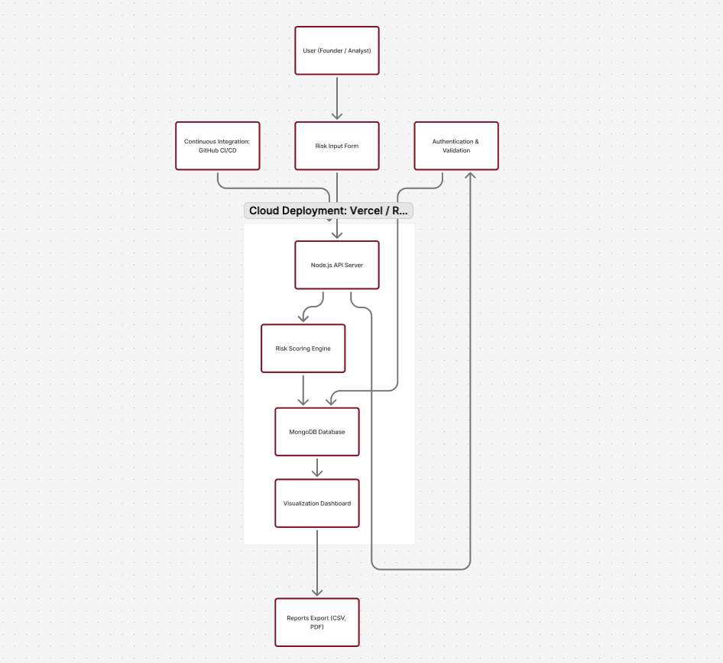
Conclusion
• Toolkit provides a low-cost, scalable, and practical solution.
• Demonstrates core data engineering principles: collection, scoring, visualization.
• Future Work: Predictive scoring, automated alerts, compliance mapping.
Startups should not wait until they scale before implementing security
A structured toolkit reduces financial, operational, and reputational risks
FlyVnox successfully demonstrates how a cloud startup can implement strong baseline controls
This model can be reused by other cloud-based companies in Africa, the U.S., and globally
The toolkit will evolve into a more complete framework (incident response, SIEM, SOC 2 readiness)
Notes:
In conclusion, this project provides a practical, low-cost solution that bridges the gap between academic cybersecurity frameworks and real-world startup needs. It highlights the value of automation and simplicity in risk management and opens the door to scalable governance solutions for small tech businesses.

Slide 12

Contribution of Team Members
• Project developed individually by Victor C. Okoli.
• Supervised by Dr. Yu (Faculty Advisor, YSU).
Dr Robert Gilland project Coach

Slide 13
Acknowledgement
• Appreciation to YSU Faculty, classmates, and mentors.
• FlyVnox case study helped bridge academic research and real-world practice.
Notes:
I’d like to thank Dr. Yu, the YSU Computer Science Department, and my classmates for their support and feedback throughout this project. This work represents how research and entrepreneurship can come together to create real impact for the next generation of cloud-based startups.

